Slide 1




Apache Commons CSV
Software Dependability
AY 2023 - 2024

Slide 2




Team members
Francesco Paolo D’Antuono
Ivan Capobianco

Slide 3



Apache Commons CSV
Overview
Parsing and writing CSV files
Flexible configuration
Open source

Slide 4


Apache Commons CSV
Size
37300
46
Lines of code
Classes

Slide 5

Apache Commons CSV
Our repository

Slide 6
Software Quality Analysis

Slide 7


SonarCloud
Analysis results
6
658
Bugs
Code smells

Slide 8

SonarCloud
Bugs
3 critical
3x multiple lambda expressions chained together that could raise the same exception

Slide 9
SonarCloud
Fix
Applied refactoring by rewriting the chained expressions making sure that only one method could raise the expected exception.

Slide 10

SonarCloud
Bugs
3 major
2x NullPointerException not handled
return value not used or stored

Slide 11
SonarCloud
Fix
All reported major bugs were identified as false positives.

Slide 12
SonarCloud
Resolved bugs
High
3/3
Medium
3/3

Slide 13
SonarCloud
Code smells
Test case without assertions
High cognitive complexity
Naming scheme for constant values
Unnecessary public modifiers

Slide 14
SonarCloud
Resolved code smells
High
29/37
Medium
9/69
Low
500/552

Slide 15


Code Coverage Analysis

Slide 16



JaCoCo
Configuration
>>
dependency
Jacoco
Maven

Slide 17
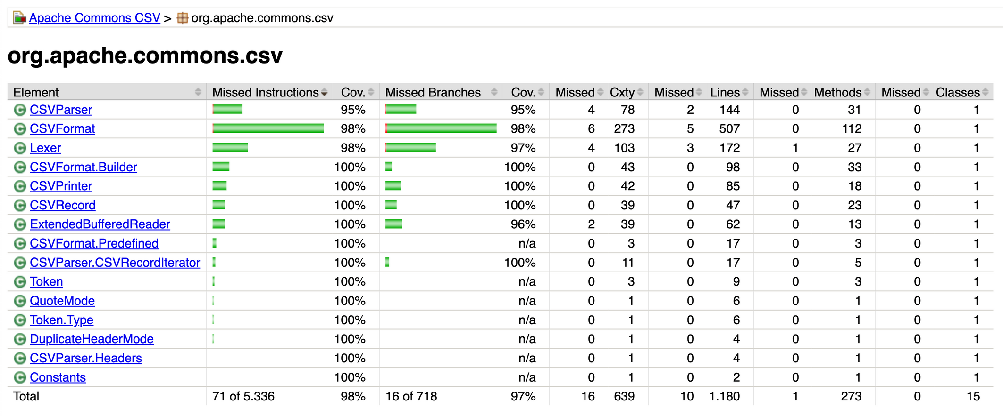
JaCoCo
Results

Slide 18


Codecov
Configuration
>>
CI/CD
pipeline
Codecov
GitHub

Slide 19
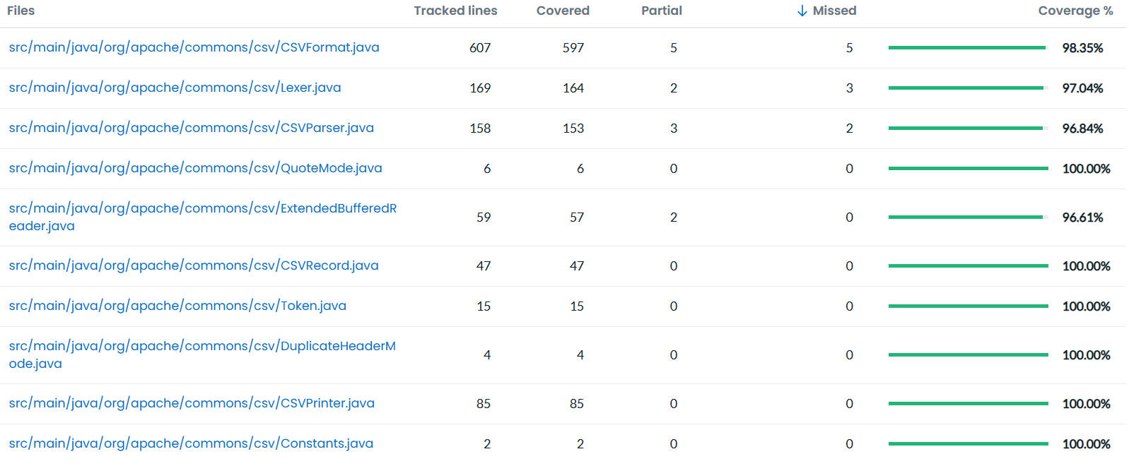
Codecov
Results

Slide 20
Mutation Testing

Slide 21

PiTest
Configuration
>>
test
dependency
PiTest
Maven

Slide 22
PiTest
Configuration
All stable mutators used
Configured to use 8 threads

Slide 23
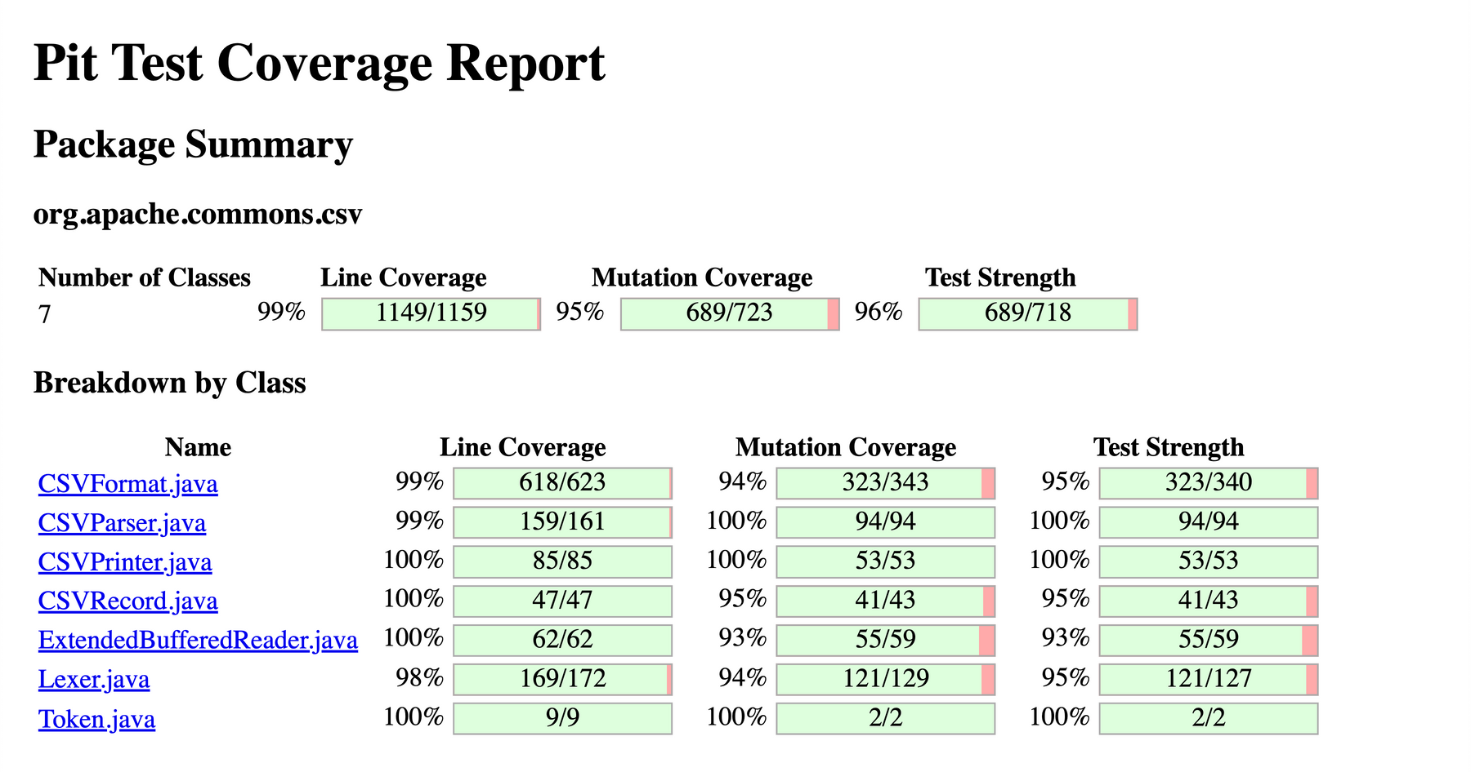
PiTest
Execution results

Slide 24
Performance Testing

Slide 25

Java Microbenchmark Harness (JMH)
Configuration
>>
benchmark profile
dependency
JMH
Maven

Slide 26



Java Microbenchmark Harness (JMH)
First execution parameters
1
5
20
Fork
Warmups
Measurements

Slide 27

Java Microbenchmark Harness (JMH)
First execution results
Execution time taken not optimal

Slide 28
Java Microbenchmark Harness (JMH)
Second execution parameters
1
3
10
Fork
Warmups
Measurements

Slide 29


Java Microbenchmark Harness (JMH)
Second execution results
Improved execution time
Good performance results

Slide 30
Java Microbenchmark Harness (JMH)
Insights
Benchmark | Avg Time (ms) | Min Time (ms) | Max Time (ms)
parseCommonsCSV | 1523.675 | 1337.792 | 1765.603
parseGenJavaCSV | 1225.577 | 1124.541 | 1295.039
parseJavaCSV | 1234.754 | 1073.294 | 1498.246
parseSkifeCSV | 1462.125 | 1307.927 | 1628.038
parseSuperCSV | 1381.573 | 1293.049 | 1526.181
read | 157.744 | 151.640 | 166.647
scan | 1140.819 | 1012.635 | 1293.638
split | 750.084 | 688.006 | 851.519

Slide 31
Automatic Test Case Generation

Slide 32

EvoSuite
Configuration
>>
jar files added
manually from
EvoSuite
GitHub

Slide 33
EvoSuite
Results
32 test cases successfully created
No bugs identified

Slide 34

Randoop
>>
jar files added
manually from
Randoop
GitHub

Slide 35
Randoop
Results
108 test cases successfully created
No bugs identified

Slide 36
Software Vulnerabilities

Slide 37


SpotBugs
Configuration
>>
plugin
SpotBugs
IntelliJ IDEA

Slide 38

SpotBugs
Identified vulnerabilities
Server-Side Request Forgery (SSRF)

Slide 39

OWASP DC
Configuration
>>
dependency
OWASP DC
Maven

Slide 40
OWASP DC
Identified vulnerabilities
No known vulnerabilities reported

Slide 41
Conclusions

Slide 42
Conclusions
Robust and well-maintened project
Medium/high code quality
High code security
High code performance

Slide 43
Thank you for your attention

